Slide 1


Comparing Airbnb listing price between 2018 and 2021
Clivia Kong

Slide 2
Timeline of Airbnb
Idea Creation for short-term living
Received total funding
around $8 million
10 million booking reached in June
2018 Datasets
2021 Datasets
2007
2009-2010
2012
Dec17– Dec 18
Dec20– Dec 21
2008
2011
2012
2020
Website launches
Reach 1 million bookings
focus on Australia market
Covid-19 Pandemic

Slide 3
Business Question
Is there any difference in the price between “Period from Dec17 to Dec18” and “Period from Dec20 to Dec21(Covid-19 pandemic)” ?

Slide 4
Data Pipeline
Region classification data
Data Acquisition
Summary
Airbnb 2018 data
Airbnb 2021 data
Business Questions
EDA
Data overview
Feature analysis
Hypothesis Tests

Slide 5
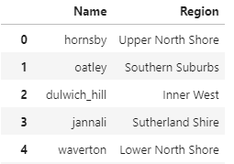
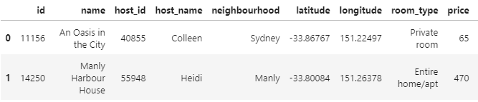
2018 Data Set and 2021 Data Set of Sydney Airbnb
Key Features
Region classification table
Id : Airbnb product ID (unique)
Neighbourhood : suburb
Room type: Entire home/apt, Private Room, Shared room, Hotel room
Price: Daily price of listing
Name: suburb
Region: region classification of suburbs
2018 Dataset:https://www.kaggle.com/datasets/tylerx/sydney-airbnb-open-data
2021 Dataset: http://insideairbnb.com/get-the-data/
Region classification table: https://sydneysuburbreviews.com/suburb-rankings/

Slide 6
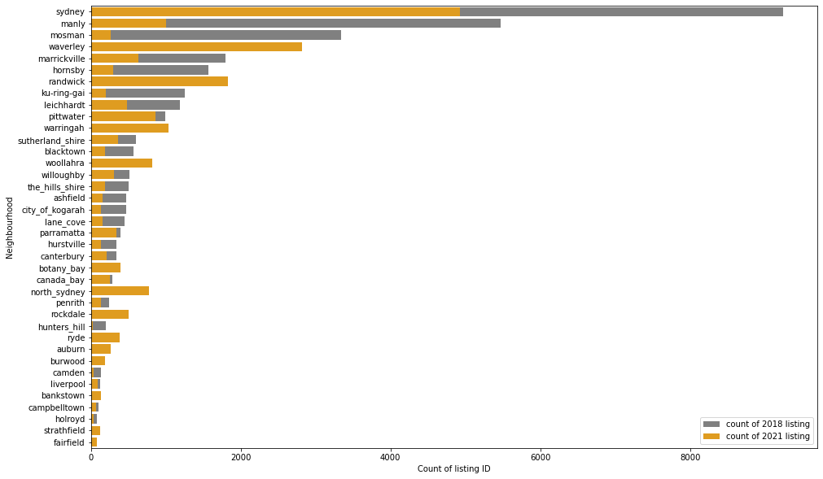
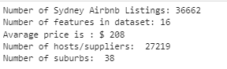
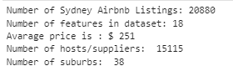
2018 & 2021 Airbnb Data - Neighborhood
2018 Dataset: Dec17- Dec18
2021 Dataset: Dec 20 – Dec21

Slide 7
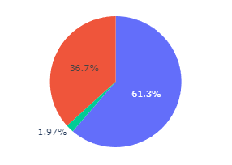
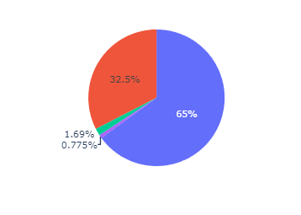
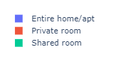
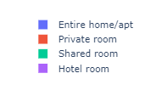
2018 & 2021 Airbnb Data – Room Type of listing
2018 Dataset: Dec17- Dec18
2021 Dataset: Dec 20 – Dec21

Slide 8
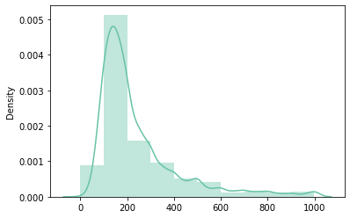
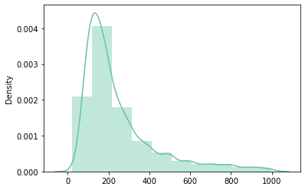
2018 & 2021 Airbnb Data – Price (Entire home/apt)
2018 Dataset: Dec17- Dec18, price < 1000
2021 Dataset: Dec 20 – Dec21, price < 1000

Slide 9
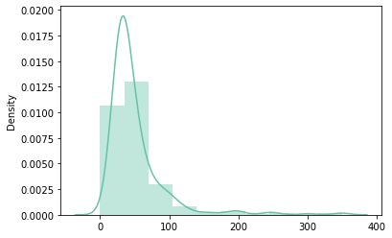
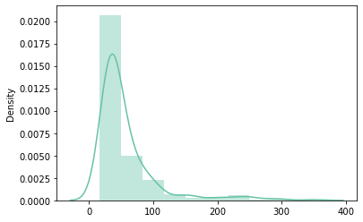
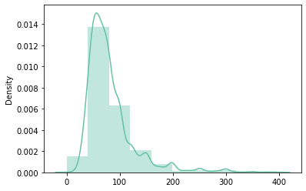
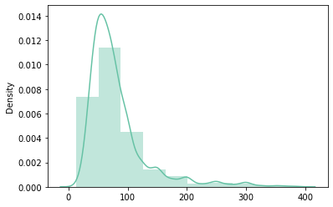
2018 & 2021 Airbnb Data – Price (Shared/Private)
2018 Dataset: Dec17- Dec18, price < 1000
2021 Dataset: Dec 20 – Dec21, price < 1000
Shared room
Private room

Slide 10
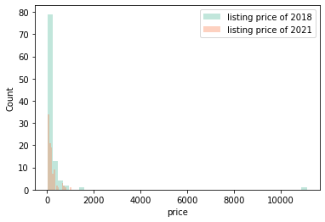
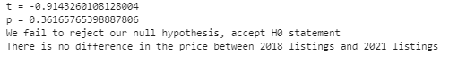
1. Is there any difference in the price between “Period from Dec17 to Dec18” and “Period from Dec20 to Dec21”
H0: There is no difference in the price between 2018 listings and 2021 listings
H1: There is a difference in the price between 2018 listings and 2021 listings
Confidence level: 95%
Sample size: 100

Slide 11
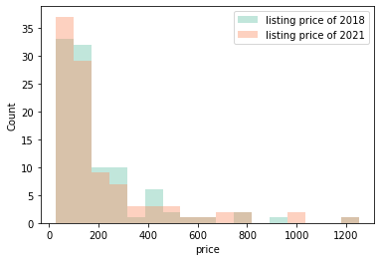
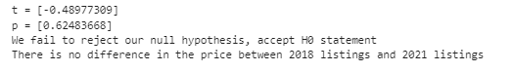
2. Is there any difference in the price between “Period from Dec17 to Dec18” and “Period from Dec20 to Dec21” For listings available in both periods?
H0: There is no difference in the price between 2018 listings and 2021 listings in dataset with same listing IDs
H1: There is a difference in the price between 2018 listings and 2021 listings in dataset with same listing IDs
Confidence level: 95%
Sample size: 100

Slide 12
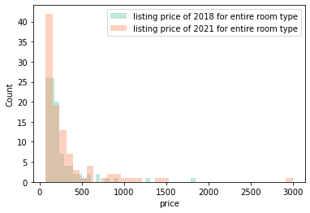
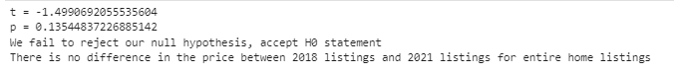
3. Is there any difference in the price between “Period from Dec17 to Dec18” and “Period from Dec20 to Dec21” For Entire home type group?
H0: There is no difference in the price between 2018 listings and 2021 listings of entire home group
H1: There is a difference in the price between 2018 listings and 2021 listings of entire home group
Confidence level: 95%
Sample size: 100

Slide 13
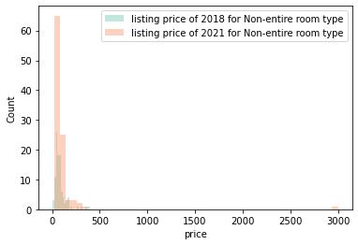
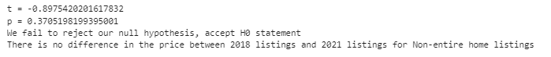
4. Is there any difference in the price between “Period from Dec17 to Dec18” and “Period from Dec20 to Dec21” For Non-entire home type group?
H0: There is no difference in the price between 2018 listings and 2021 listings of Non-entire home group
H1: There is a difference in the price between 2018 listings and 2021 listings of Non-entire home group
Confidence level: 95%
Sample size: 100

Slide 14
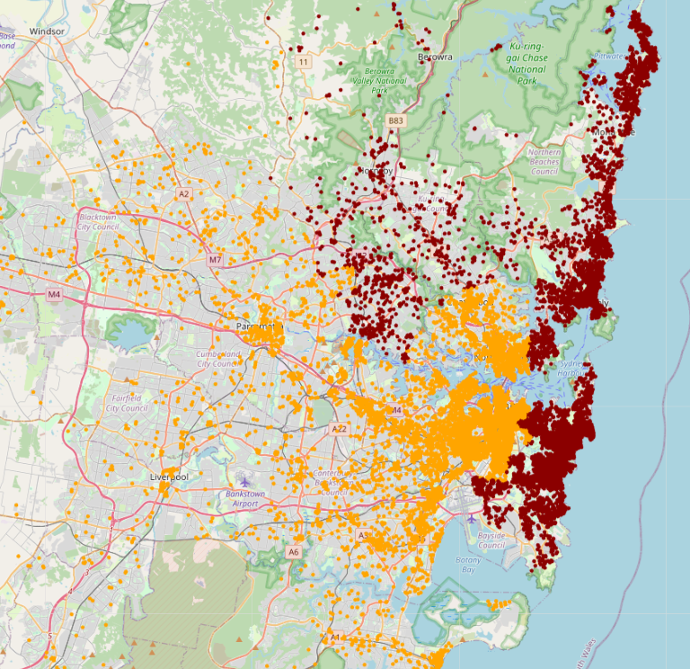
5. Is there any difference in the price between “Period from Dec17 to Dec18” and “Period from Dec20 to Dec21” For each region group?
Region | Result
Sydney_cbd | H0
Northern Beaches | H1
North Shore | H1
Eastern Suburbs | H1
Inner West | H0
Upper North Shore | H1
Northern Suburbs | H1
Southern Suburbs | H0
Western Suburbs | H0
Lower North Shore | H0
Northern West | H0
Northern West | H0
Price changed
Price unchanged

Slide 15
Summary
The number of listing ID in 2021 is significantly lower than the listing ID in 2018.
The listing price of 2021 is similar with listing price of 2018
The listing price of Northern and Eastern suburbs are changed`

Slide 16

Next Steps:
Further analysis the regions that have the difference by suburbs through hypothesis testing
Identify the price change direction of the regions/suburbs which have price changed
Analysis the reason causes the price change in these regions/suburbs
Compare each month of transactional price between two periods to see whether price changed in specific month
Analysis the correlation of price with other features to find out what drives the price change
Clivia Kong

